Slide 1

Introduction To Linear Regression
Abhishek Srivastava
Data Scientist
Tata Consultancy Services

Slide 2

Introduction To Linear Regression

Slide 3
Simple models for Prediction Linear Regression The Line of Best Fit Using Linear Regression for prediction Evaluate your Model – R square and Adjusted R squared Using all the features for prediction Bias and Variance
Key Points

Slide 4

Model 1: Mean Prediction
Mean prediction is simply predicting average of a quantitative parameter.
Ex: Predicting Sales of an item based on past records

Slide 5
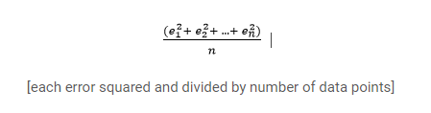
But How Good is my Prediction????
Check Mean Squared Error
The difference in the predicted and actual values divided by the number of observation will
give you mean error. Square each term so as to avoid cancelling out of the Positive and negative error.

Slide 6
Model 2: Average Sales by Location
We know that location plays a vital role in the sales of an item. For example, let us say, sales of car would be much higher in Delhi than its sales in Varanasi.

Slide 7

Linear Regression
Linear regression is the simplest and most widely used statistical technique for predictive modeling. It basically gives us an equation, where we have our features as independent variables, on which our target variable [sales in our case] is dependent upon.

Slide 8

Simple Linear Regression
A simple Linear regression will have only one Independent variable. Independent variables are also called predictor variables. The term present on right side of the equation is called dependent variable also called Response variable.

Slide 9
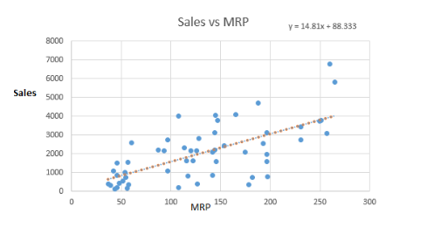
Sales VS MRP

Slide 10
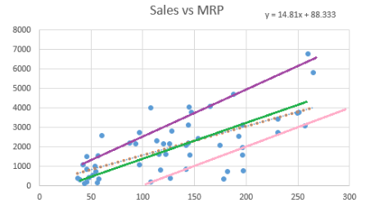
We can fit as many lines as we want but the question is to find the best fit line

Slide 11
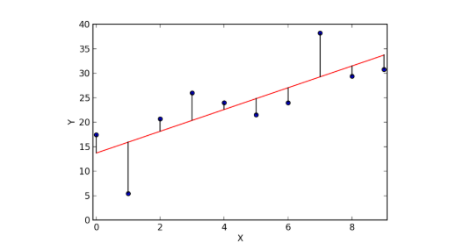
The best file is the one for which the error is less

Slide 12
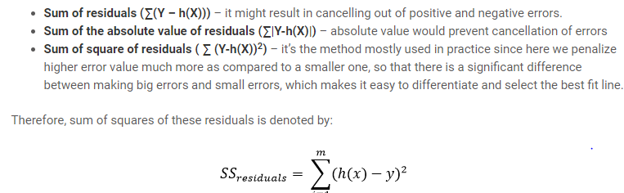

Slide 13

Model 3 – Linear Regression
Lets move to Jupyter Notebook

Slide 14
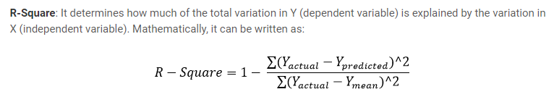
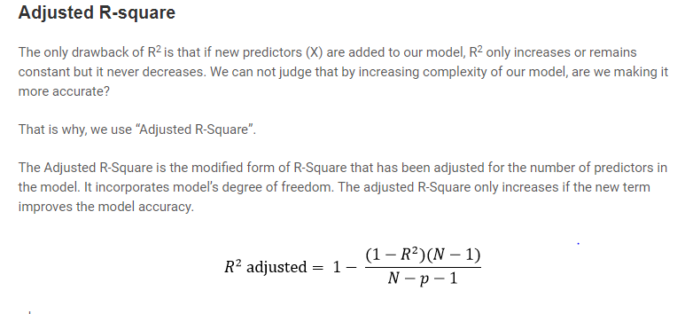
Evaluation Criteria

Slide 15
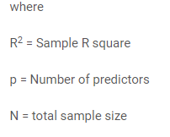

Slide 16
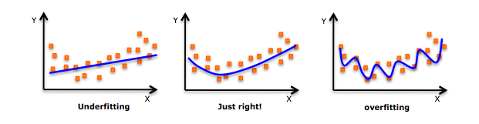
Bias and Variance

Slide 17
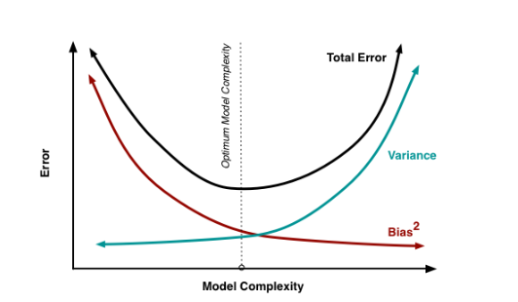
Perfect Model will find a trade-off between bias and Variance

Slide 18
Multicollinearity and Variance Inflation Factor
In statistics, multicollinearity (also collinearity) is a phenomenon in which one predictor variable in a multiple regression model can be linearly predicted from the others with a substantial degree of accuracy.
To check Multicollinearity, We use Variance Inflation Factor.
Variance Inflation Factor (VIF) - It provides an index that measures how much the variance (the square of the estimate's standard deviation) of an estimated regression coefficient is increased because of collinearity.
VIF = 1 / (1-R-Square of j-th variable) where R2 of jth varible is the coefficient of determination of the model that includes all independent variables except the jth predictor.
Where R-Square of j-th variable is the multiple R2 for the regression of Xj on the other independent variables (a regression that does not involve the dependent variable Y).

Slide 19
Threshold VIF: 5 (If VIF > 5 then there is a problem with multicollinearity.
VIF > 10 : implies Serious multicollinearity.

Slide 20
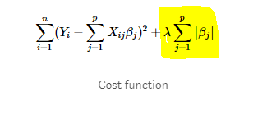
Lasso Regularization (L1)
Lasso Regression (Least Absolute Shrinkage and Selection Operator) adds “absolute value of magnitude” of coefficient as penalty term to the loss function.
Here, if lambda is zero then we will get back OLS whereas very large value will make coefficients zero hence it will under-fit.

Slide 21
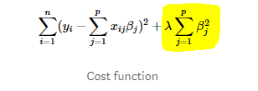
Ridge Regression(L2)
Ridge regression adds “squared magnitude” of coefficient as penalty term to the loss function. Here the highlighted part represents L2 regularization element.
Here, if lambda is zero then you can imagine we get back OLS. However, if lambda is very large then it will add too much weight and it will lead to under-fitting. Having said that it’s important how lambda is chosen. This technique works very well to avoid over-fitting issue

Slide 22
The key difference between these techniques is that Lasso shrinks the less important feature’s coefficient to zero thus, removing some feature altogether. So, this works well for feature selection in case we have a huge number of features.

Slide 23



www.linkedin.com/in/aabbhishekk
abhisheksrivastava501@gmail.com

